Slide 1
Study on new york city’s citibike
Xiao Wei Lim
JiaZhuang Feng
RuiYi Wu

Slide 2
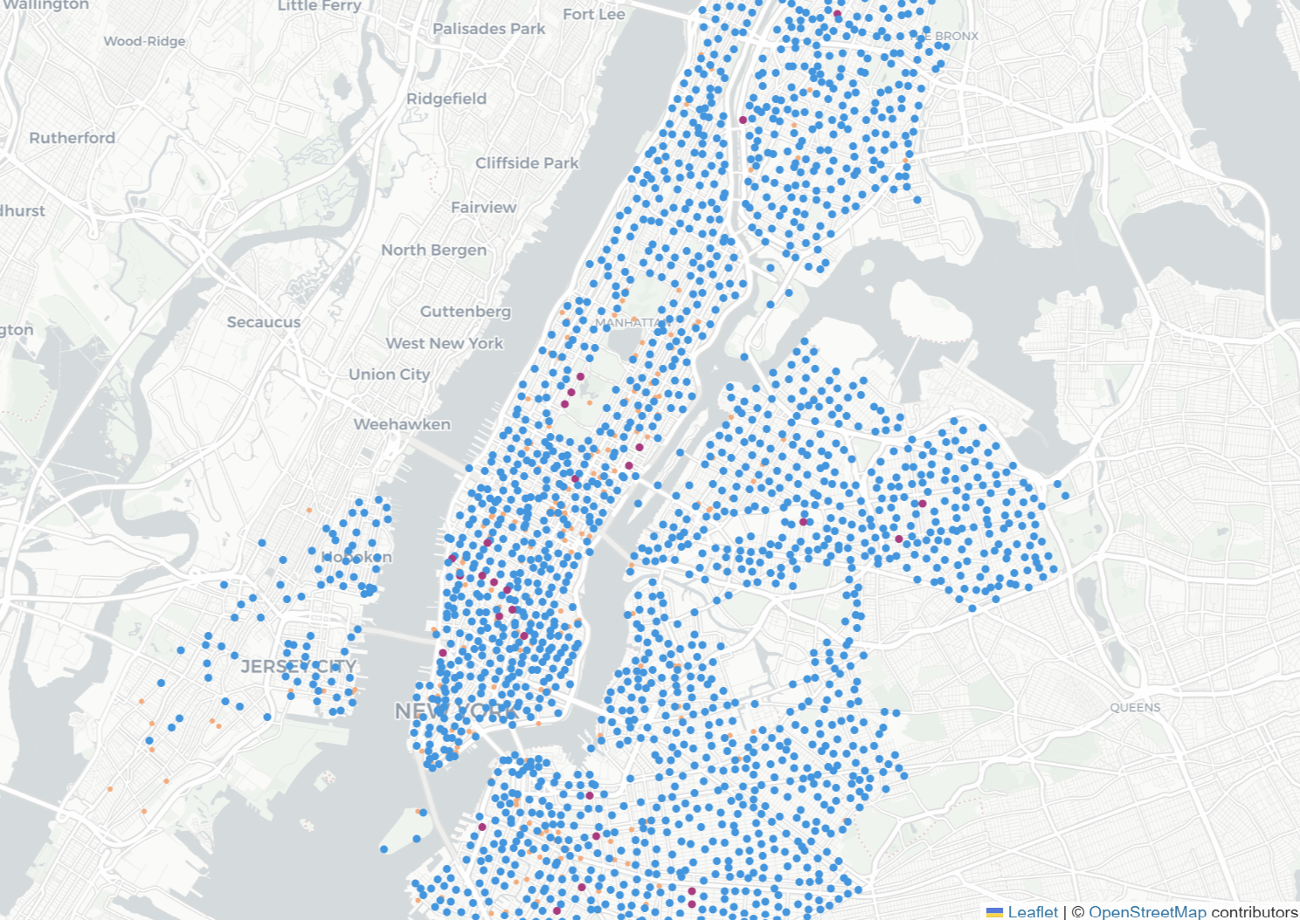
Background
Why New York CitiBike
Station Distribution
CitiBike Overview: Launched in 2013, the largest bike-sharing system in the U.S
Importance of Study: Analyzing usage data helps identify peak times, station popularity, and provides insights for optimizing city planning and resource allocation.
Previous Studies: Research indicates CitiBike usage is affected by factors like weather, community demographics, and time of day.
CitiBike Station Usage Clusters
COVID-19 Impact on London Bike Usage
Global Bike-Sharing System Classification

Slide 3
Analysing NYC CitiBike Usage Patterns In 2019
Citibike Ride Patterns are Significantly Influenced by Different Factors across Different Seasons
PROJECT TITLE
HYPOTHESIS

Slide 4
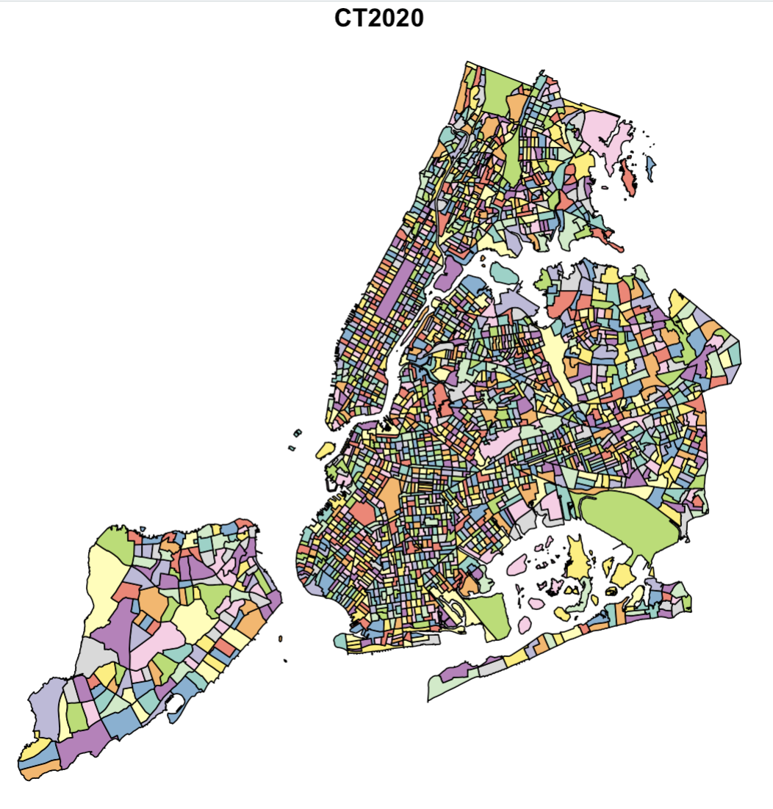
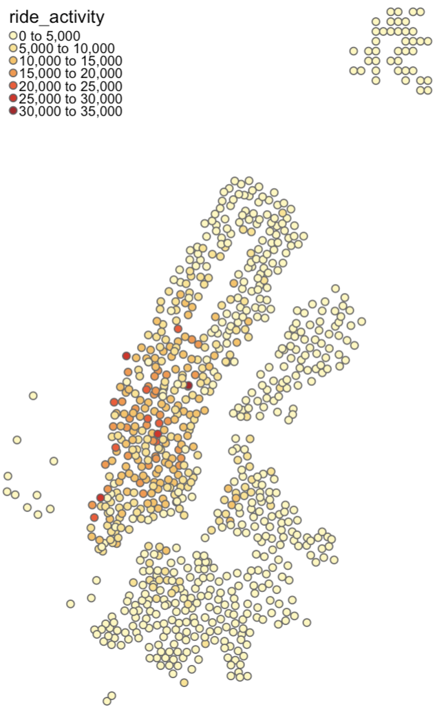
DATA REQUIREMENTS AND SOURCES
BIKE DATA
DEMOGRAPHIC DATA
Citi Bike System Data
Source: Lyft (Citi Bike operator) in collaboration with the NYC Department of Transportation
NYC 2020 Census Data
Source: NYC Department of City Planning & US Census Bureau
Description/ Metadata
Trip Duration (seconds) Start Time and Date Stop Time and Date Start Station Name End Station Name Station ID Station Lat/Long Bike ID User Type (Customer = 24-hour pass or 3-day pass user; Subscriber = Annual Member)
Description/ Metadata
Census ID Population: Male/Female 5-year band Ages (e.g. 0 to 4 yrs) Housing Units Average Household Size Family Numbers Institution-related Housing Count (e.g. schools)
Key limitation to data:
Census exercise is conducted decentenially, with the latest edition in 2020. However, the demographics may have changed significantly since COVID-19 for post-2020. Hence the latest data pair we can use is likely 2019 Citibike data with the 2020 Census Data.

Slide 5
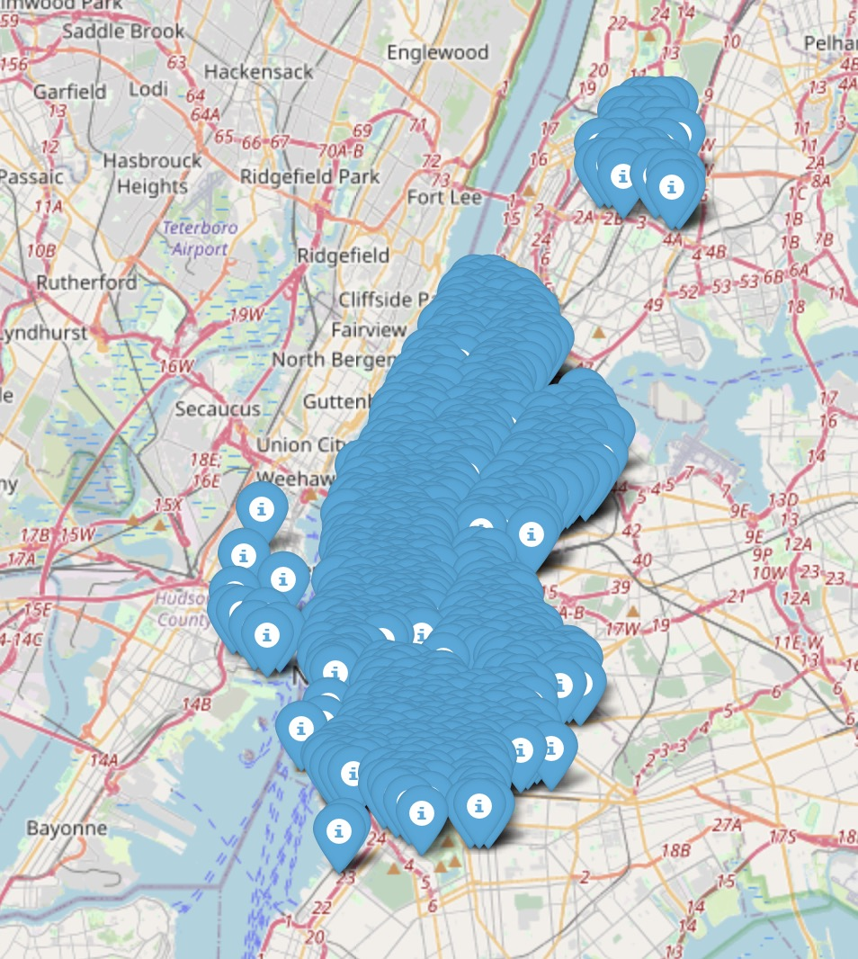
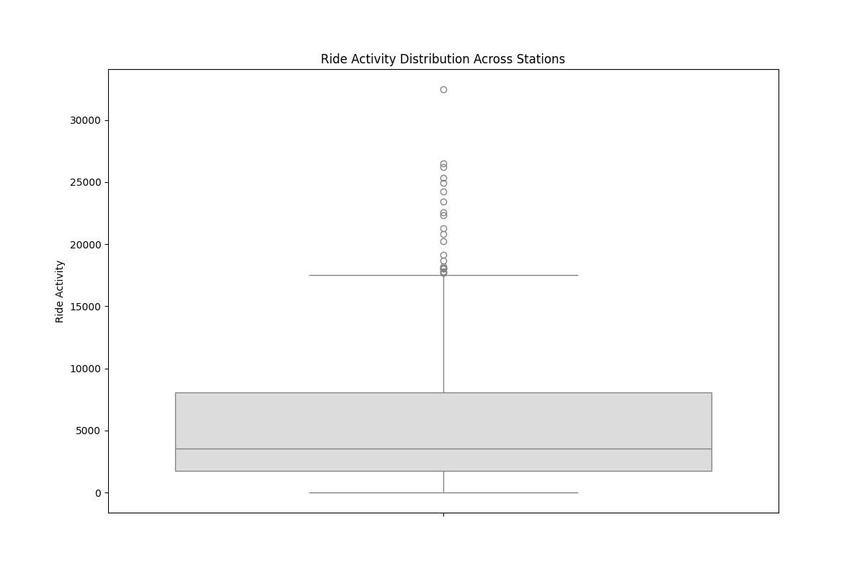
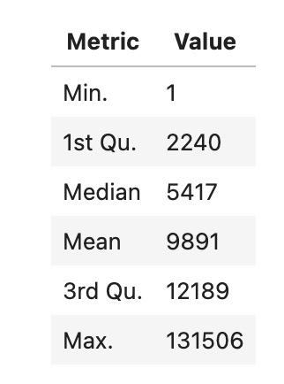
SOME EXPLORATORY SPATIAL DATA ANALYSIS
Citibike Dataset
ride activity = ride start count + ride end count
Figure 2: Ride Activity Distribution (in July 2019)
Figure 1: Stations Map

Slide 6
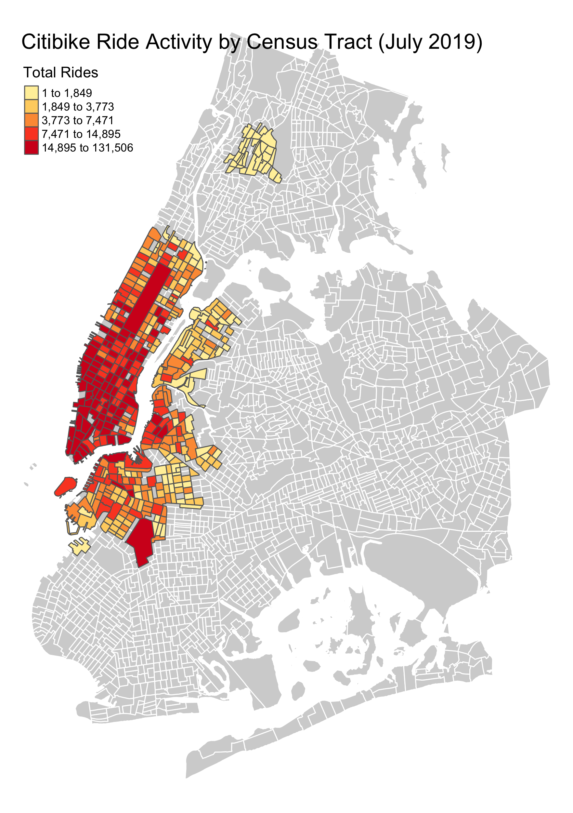
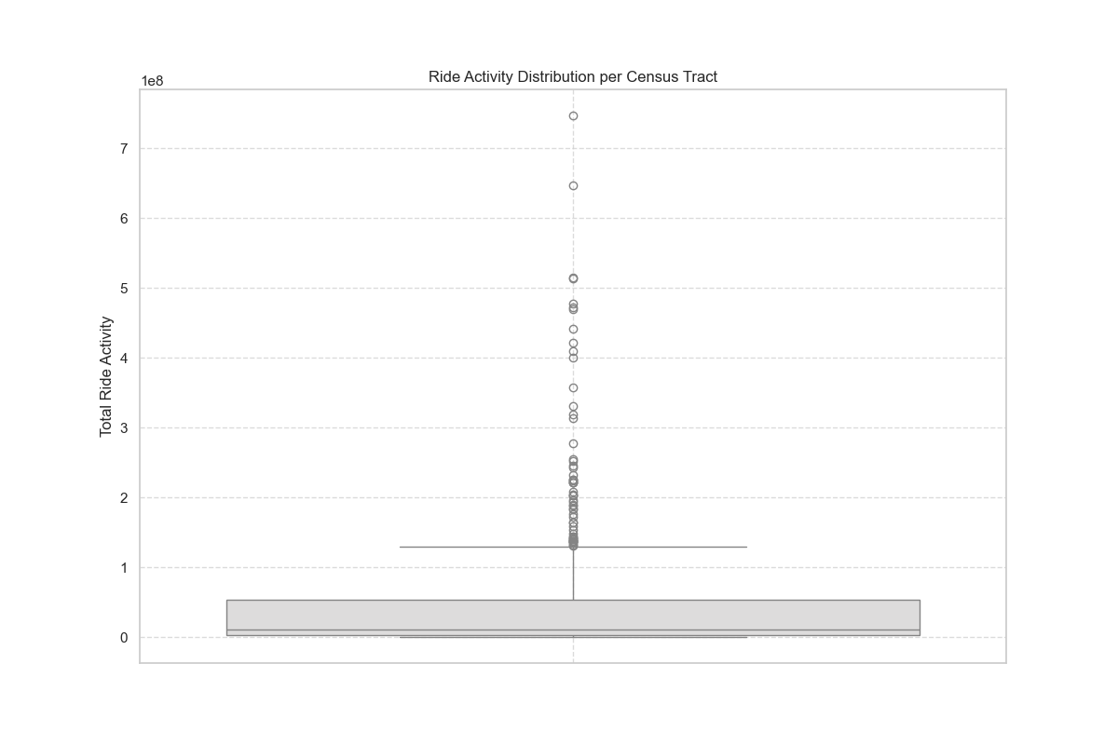
SOME EXPLORATORY SPATIAL DATA ANALYSIS
Census Tracts
Description
Among 2,325 Census Tracts, 441 of them have Citibike data. This map shows the citibike ride activity by census tract. Citibike ride activities are most frequent in Manhattan.
Figure 3: Citibike Ride Activity
Figure 4: Ride Activity Distribution (Census)

Slide 7
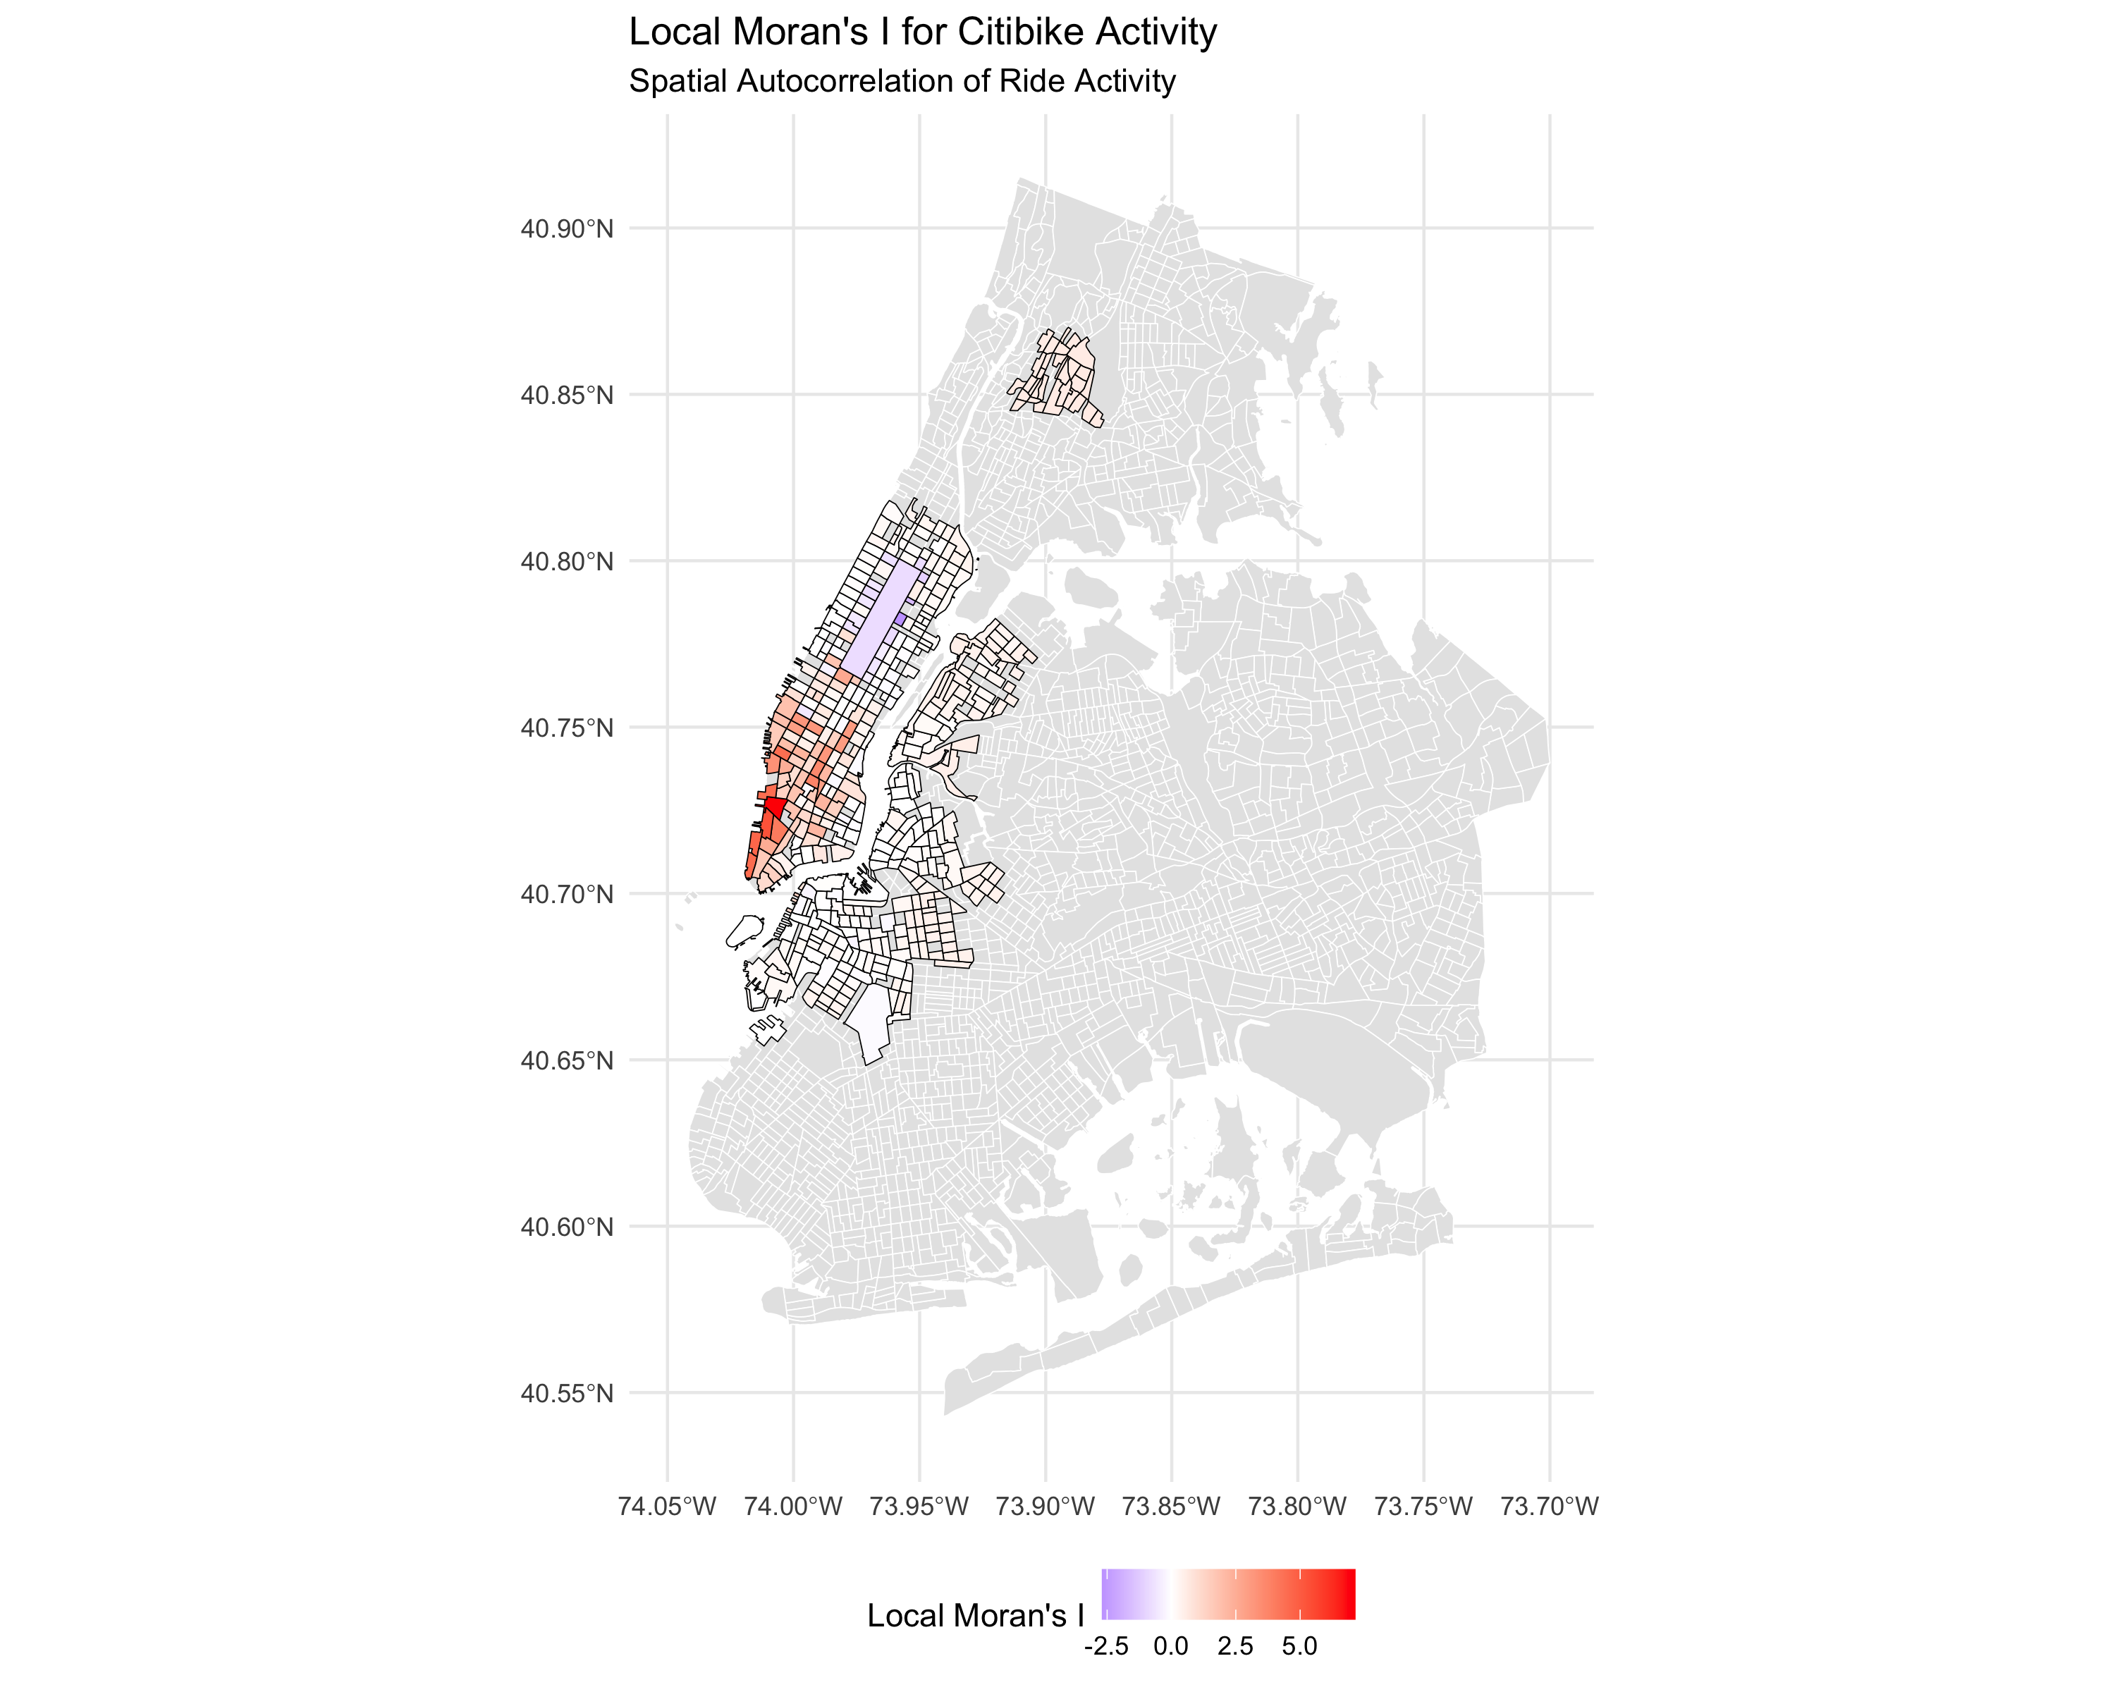
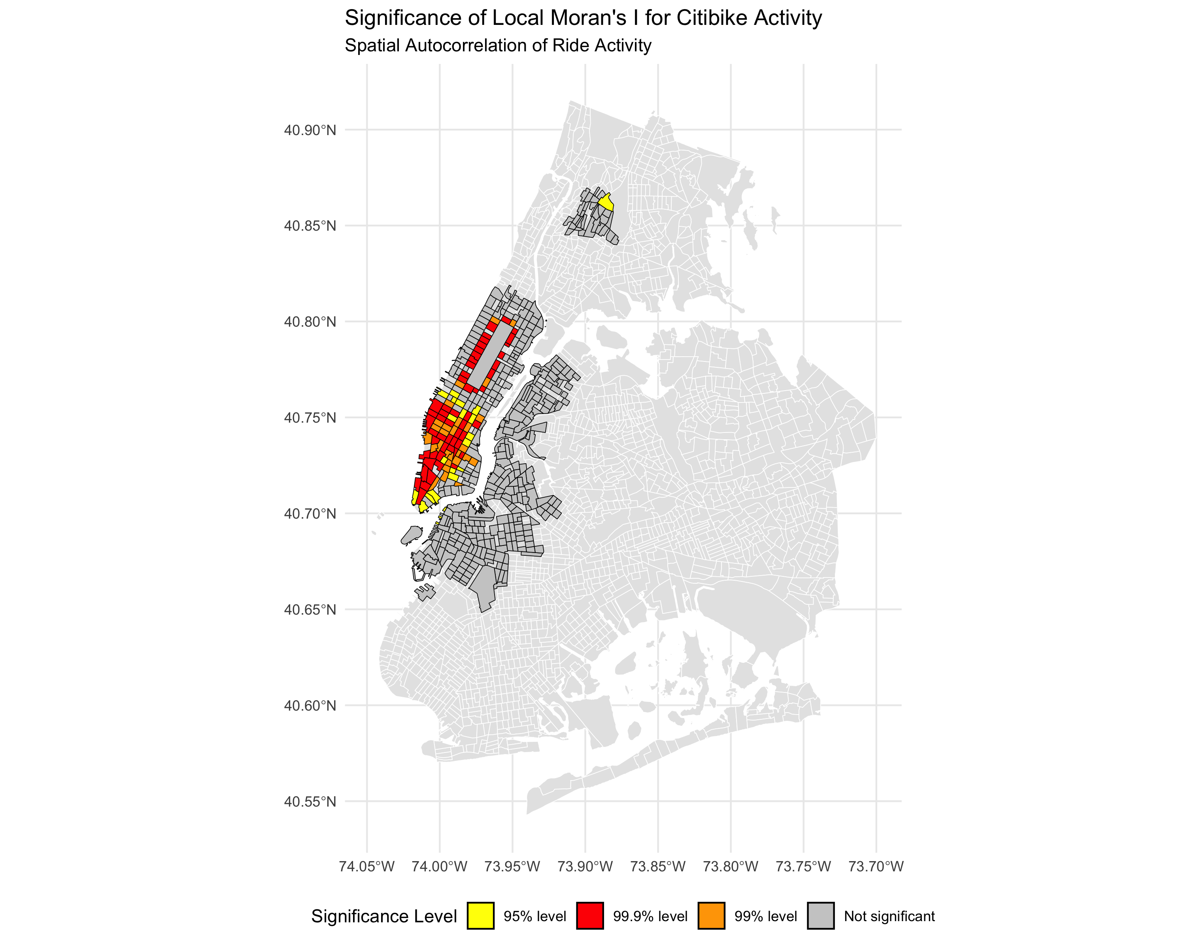
SOME EXPLORATORY SPATIAL DATA ANALYSIS
Spatial Autocorrelation Analysis
Description
The colors range from blue to red, indicating the intensity of spatial autocorrelation. Red areas represent high clusters.
Description
High significance levels are in central and lower parts of Manhattan.
Figure 5: Local Moran's I
Figure 6: Significance Test

Slide 8
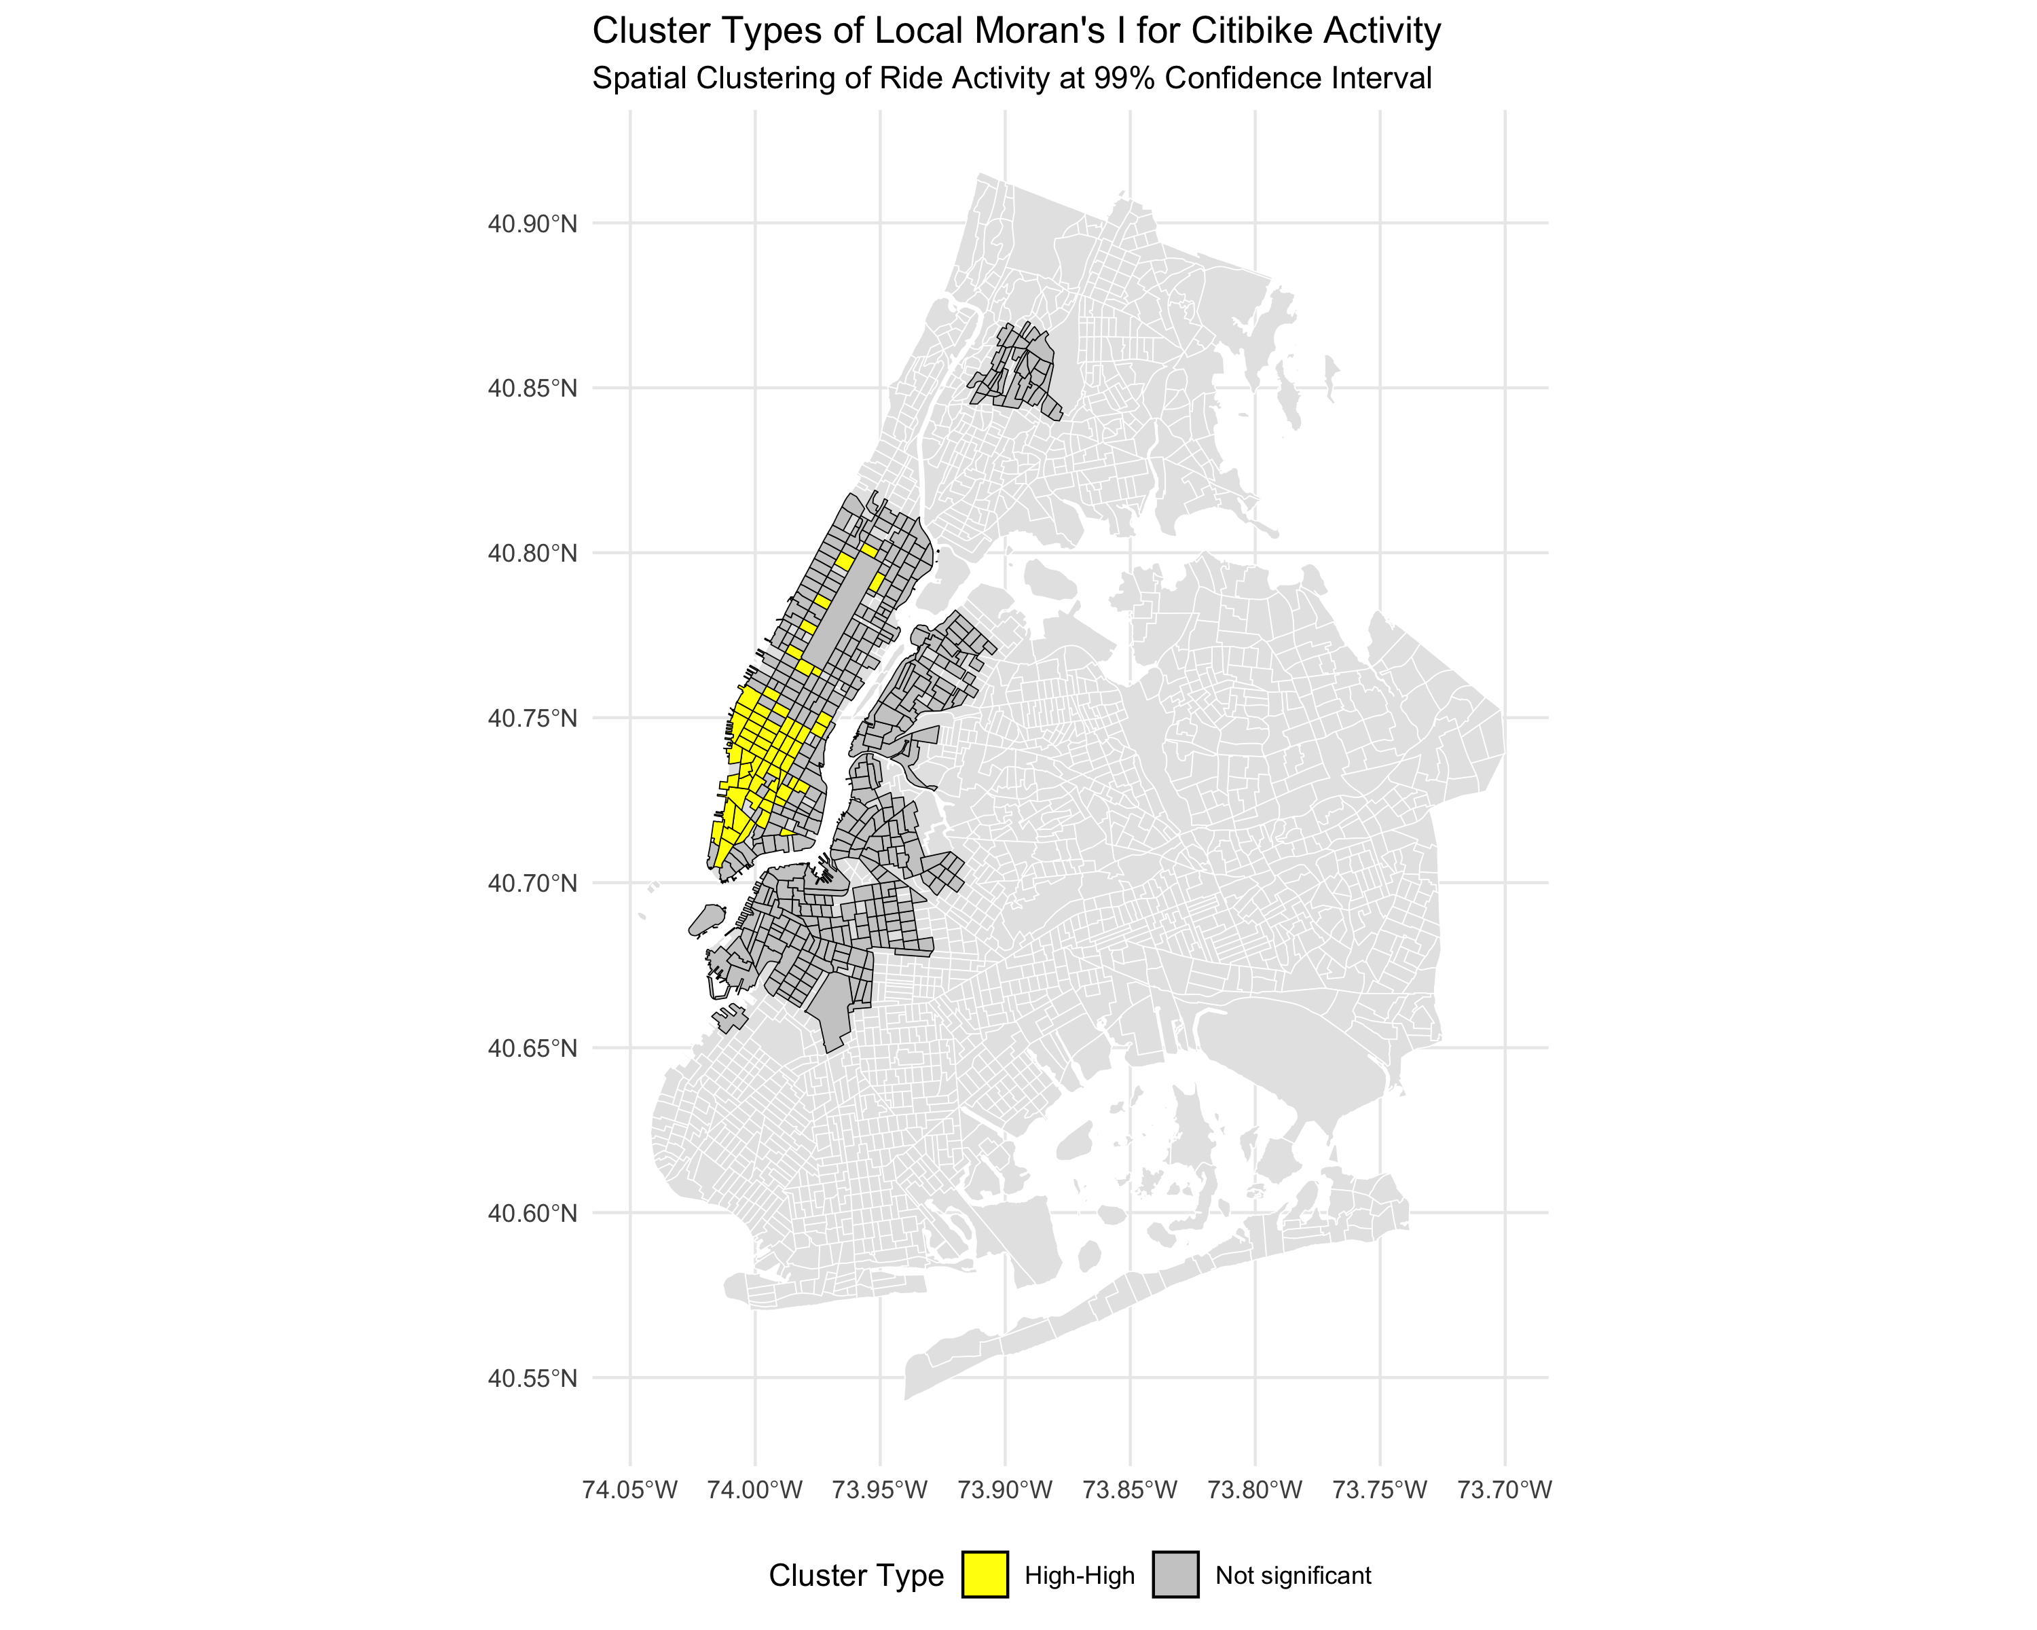
SOME EXPLORATORY SPATIAL DATA ANALYSIS
Local Indicators of Spatial Association
Description
Yellow areas with high ride activity are surrounded by same high ride activity.
Figure 7: Local Moran's I Cluster

Slide 9
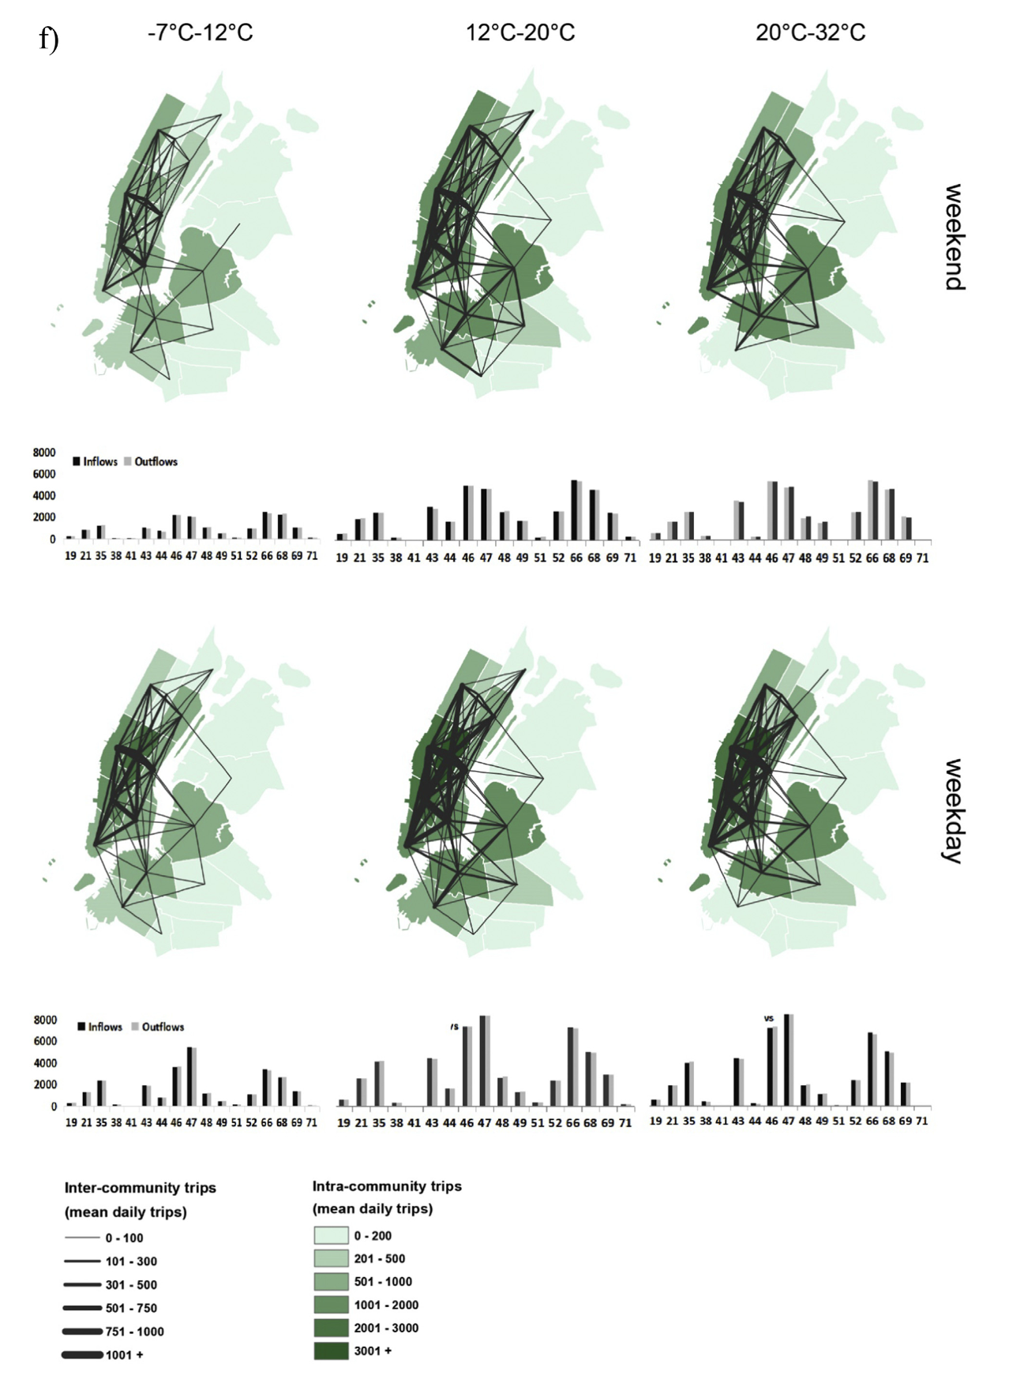
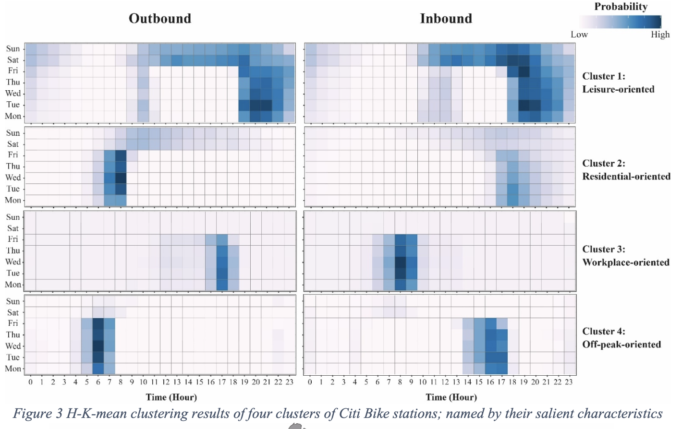
1. What has been done before?
2. How are we approaching this?
METHODOLOGICAL APPROACH
3. What analysis methods are we using? 4. How will we validate our approaches?
LIT REVIEW
Weather (temp + precipitation) is a key determinant to bike use
2
Bike use patterns have significant clusters based on its time of use – Weekdays Peak/Off-Peak, Weekends
1
An et al (2019) - Weather and cycling in New York: The case of Citibike
[see also:] Jiang et al (2021) - A Dynamic Model Averaging for the Discovery of Time-Varying Weather-Cycling Patterns
Liu et al (2021) - Profiling the Dynamic Pattern of Bike-sharing Stations: a case study of Citi Bike in New York City
[see also:] Noland et al (2018) - Bikesharing Trip Patterns in New York City: Associations with Land Use, Subways, and Bicycle Lanes
Notes:
Spatial statistical research in this area of docked bikes is very active, particularly with publicly shared datasets such as the Citibike system in NYC, or even the Santander bikes in London. We took two key learning points
1- Weather is a key determinant for Citibike ridership
2- Bike usage can be clustered based on its temporal nature – Weekdays Peak or Off-Peak, Weekend Leisure Activities

Slide 10
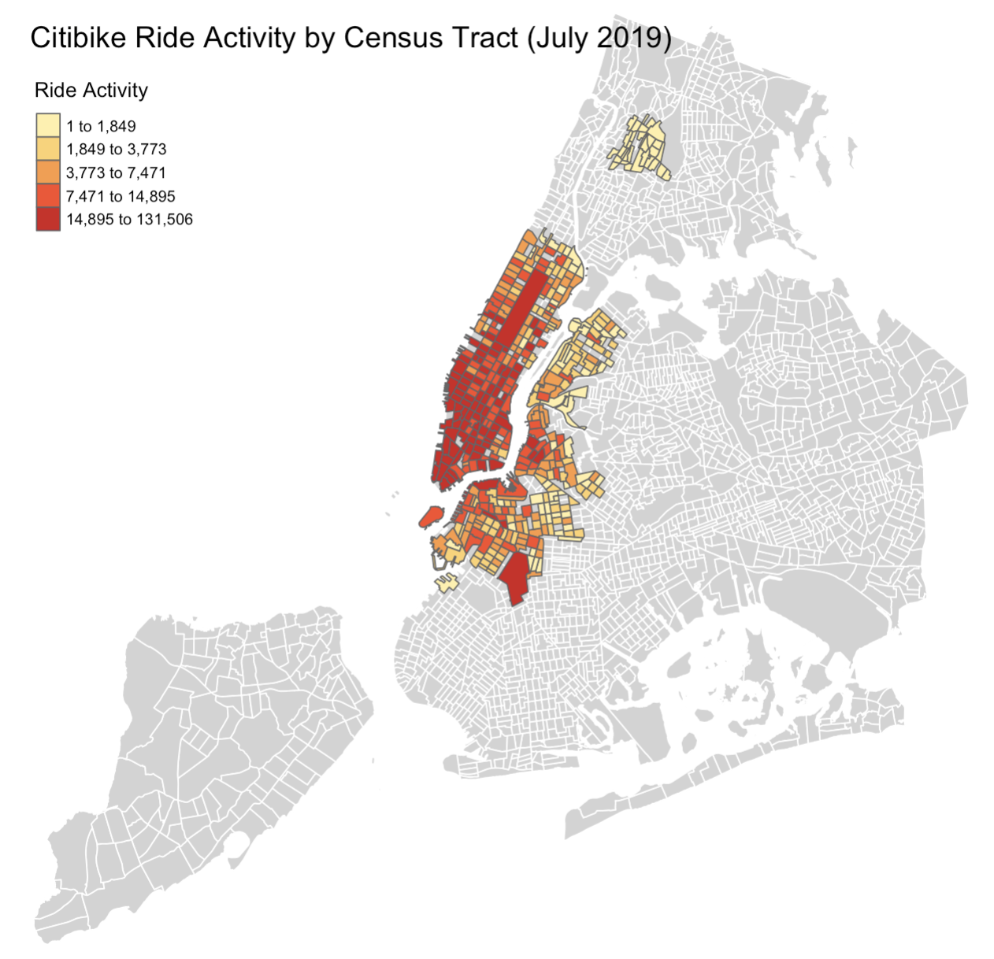
1. What has been done before?
2. How are we approaching this?
METHODOLOGICAL APPROACH
3. What analysis methods are we using? 4. How will we validate our approaches?
PROPOSED STUDY
Bike usage differs based on weather
Identify what are the spatial and demographic factors affecting bike ride activity in the summer
Scenarios
WINTER
2019 CITIBIKE DATA
Jan 2019
through explanatory demographic variables such as:
population
number of housing units
number of school-related housing
number of population under 18, 18-65 yrs, above 65
SUMMER
July 2019
AUTUMN
October 2019

Slide 11
1. What has been done before?
2. How are we approaching this?
METHODOLOGICAL APPROACH
3. What analysis methods are we using? 4. How will we validate our approaches?
PROPOSED METHODOLOGY
Using the same spatial & demographic variables affecting bike ride activity in three different seasons
Different regression models will be applied to find the best fit, and then compared against each other
Scenarios
Variables
Regression Models
Best Fit for Each Season
WINTER
2019 CITIBIKE DATA
Jan 2019
population
housing units
SPATIAL LAG
WINTER
age band
?
school housing
SPATIAL ERROR
SUMMER
SUMMER
AUTUMN
July 2019
(spatial) location
SPATIAL DURBIN
AUTUMN
weekday / weekend
?
peak / off-peak
GEOGRAPHICALLY WEIGHTED REGRESSION
Validate with data from preceding week/ previous year
October 2019
median trip duration

Slide 12
PROJECT PLAN & TIMELINE
Oct
Nov
Dec
Lit Review
Data Sourcing
Exploratory Data Analysis
Exploratory (Spatial) Data Analysis
Spatial Regression
Review and Test
Report Writing

Slide 13
extra images

Slide 14
